Slide 1

Improving HBase reliability at Pinterest with Geo-replication and Efficient Backup
Chenji Pan
Lianghong Xu
Storage & Caching, Pinterest
August 17,2018
Notes:
Hello, everyone, my name is Chenji and this is Lianghong. We’re from Pinterest’s storage and caching team. Today, we’re gonna present our works in past year, which mainly focus on multicell and efficient backup for hbase.

Slide 2
Content
HBase in Pinterest
01
02
Multicell
03
Backup
Notes:
First, I’m gonna go through how Hbase is used in Pinterest. Then I’m gonna talk about the our multicell work for hbase. Since Pinterest uses AWS, you can think cell as a region or a data center in AWS. After that, Lianghong will present the hbase efficiency backup work.

Slide 3
HBase in Pinterest
01

Slide 4

HBase in Pinterest
Use HBase for online service since 2013
Back data abstraction layer like Zen, UMS
~50 Hbase 1.2 clusters
Internal repo with ZSTD, CCSMAP, Bucket cache, timestamp, etc
Notes:
We started to use hbase for online service since 2013. It is used as backend storage engine for data abstraction layer like Zen and UMS. Zen is like Facebook’s TAO, which deal with graph based data. And UMS is our key-value abstraction data service. Currently, we have around 50 Hbase clusters running on 1.2 version. Our internal build is based on 1.2, but supports more features like zstd, ccsmap, offheap bucket cache. We also changed the hbase protocol to support annotations and return the timestamp for write.

Slide 5
Multicell
02

Slide 6
Why Multicell?
Internationalization
Reliability
Latency
2012
2013
2014
2015
2016
2017
Notes:
So multicell. Why multicell? In past few years, Pinterest started to investigate internationalization and more than half of our active users are from out of states. So to provide a more reliable and lower latency service, we decided to explore the multicell solution for our infrastructure.

Slide 7

Architecture
US-East
US-West
Global Load Balancer
Local Load Balancer
Local Load Balancer
…
…
Data Service
Cache
Data Service
Cache
DB
DB
Replication
Notes:
Here is the basic architecture for our stack in multicell environment. We have a global load balancer managed by our traffic team, the global load balancer will forward the traffic to the nearest cell. In each cell, we have similar mirror stack which contains local load balancer, frontend, backend services, data services, cache and database. The data service are the abstraction service like Zen, which will call DB or cache to read or write data. And the source of truth database will replicate data to remote db. And no cross cell traffic is allowed except data service and db layer.

Slide 8
Master-Master
US-East
US-West
write req:
key: val
write req:
key: val
Data Service
Data Service
Invalidate
Invalidate
Update
Cache
Update
Cache
DB
DB
Replication
Notes:
We provide two patterns for different consistency level based on table. So you can mark your case as master-master or master-slave. Master-master, or sometimes we called it “alive-alive” means that both cell can take the write traffic. You can see from the graph that, in each cell, write request will be executed in local db and the changes will be synced up by a bi-direction replication flow. This pattern is mainly used for cases that do not have strong requirements on consistency and data conflicts is less likely to happen, which is pretty common for most of clients’ use cases.

Slide 9
Master-Slave Write
US-East
US-West(Master)
write req:
key: val
Forward
Data Service
Data Service
Set Remote Marker
Remote Marker Pool
Update
clean
DB
DB
Replication
Notes:
And for cases need stronger consistency and avoid conflicts. For example, cases related to compete for primary key like email, username sign up. Another pattern we provide is master-slave. So here, if west is the master cell. Only database in west side can take the write traffic. If a write request is sent to east data service, it will forward all the write traffic to remote peer and remote peer will update the master db. The one way replication will sync the data between dbs in cells. And here we introduce another concept, remote marker, data service in east side here will set the remote marker after getting response from remote peer. Remote marker means that the related data is out of date in local db and needs to go to remote cell for latest data. And it will be cleaned as long as the data got replicated to local db.

Slide 10
Master-Slave Read
US-East
US-West(Master)
read req:
key
Read remote
Data Service
Data Service
Check Remote Marker
Read Local
Remote Marker Pool
Read
DB
DB
Notes:
So for read request, data service will check the remote marker and depends on the result, it will decide either forward the read traffic or read the data from local db. We setup a big enough Memcached cluster with replica to be used as remote marker pool. So originally, we depends on TTL to clean the remote marker. So remote marker will be cleaned after expiration. But it is pretty hard to tune a static TTL to appropriate value. Longer TTL will lead to more cross cell traffic which means higher latency and cost. Lower TTL may cause the markers to be cleaned before replication is arrived. So we introduce a new system to clean the marker as long as the replication arrives.

Slide 11
Cache Invalidation Service
US-East
US-West
write req:
key: val
Data Service
Data Service
Cache
Invalidate
Invalidate
Update
Cache
Cache Invalidation Service
DB
DB
Replication
Consume
Kafka
Notes:
So cache invalidation service, which will clean remote marker. Cache invalidation will also deal with another consistencies issue we met in our multicell environment which is between cache and db. So no matter in master-master or master-slave patterns, there is always the case that the write traffic is taken care in remote cell and since our cache invalidation logic stays in data service, we’ll not be able to invalidate the related cache entry if the write request happened in another cell. To conquer this issue, we developed database change system with kafka and cache invalidation service. So all the database changes will be published to kafka and cache invalidation service will consume the event and infer the related cache keys based on customized mapping logic. So as long as the local db got latest data with replication flow, the out of date entries will also be invalidated from cache. And at same time, remote marker will be cleaned with similar logic.

Slide 12


DB
Mysql
HBase
Notes:
Previously, we talked about our multicell architecture in general but did not touch how it is embedded with different kinds of database. In the following parts, I’ll go through how it works with mysql and hbase, which are the major two databases we used for online services in Pinterest.

Slide 13
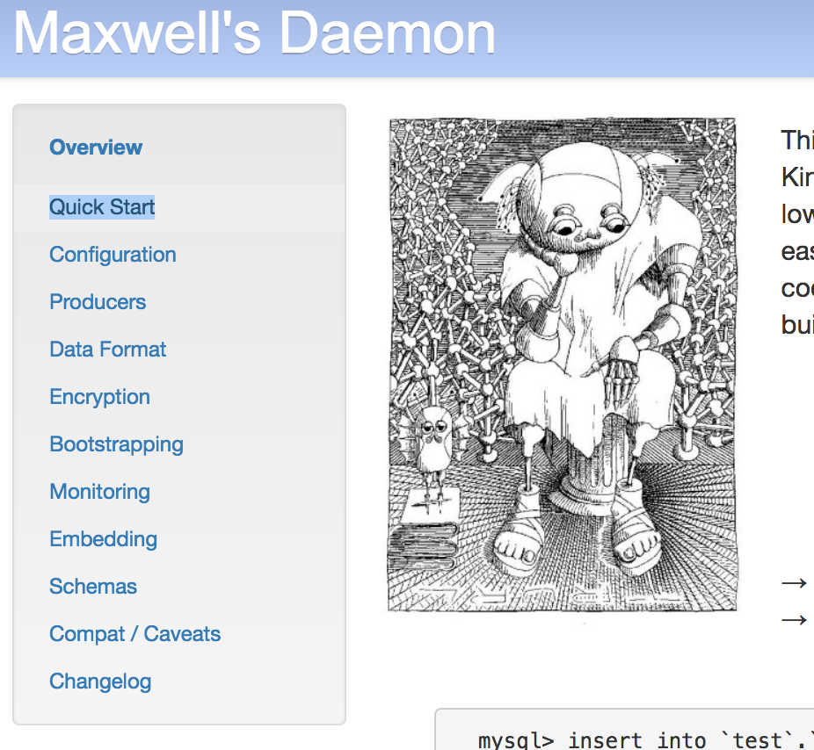
Mysql
Maxwell
Mysql Comment
Notes:
So actually, when we designed the architecture, it is mainly based on mysql. Mysql is very friendly to this multicell solution because Facebook has already explored the similar idea with mysql and we can simply adapt some open source projects like Maxwell and mysql’s feature like comment.

Slide 14
Cache Invalidation Service
US-East
US-West
write req:
key: val
Data Service
Data Service
Cache
Invalidate
Invalidate
Update
Cache
Cache Invalidation Service
DB
DB
Replication
Consume
Kafka
Notes:
So here. The database needs to publish the changes to kafka event with some customized information for consumer. Maxwell is a open source project published by Zendesk to read binlog and write row updates to queue system like kafka. Mysql comment is the feature that allow clients to add customized info in the sql query and will be part of binlog entry. So in the architecture described above, the cache invalidation service will consume the database change event and the customized info in the event to infer the cache entries.

Slide 15
Mysql and HBase
DB | Kafka | Comment
Mysql | Maxwell | Mysql Comment
HBase | HBase replication proxy | Hbase Annotations
Notes:
So to make Hbase adapt or embedded into our multicell architecture, we developed corresponding solutions as Maxwell and comment for mysql, which we called hbase replication proxy and hbase annotations. The hbase replication proxy will publish the hbase changes to kafka and the hbase annotations allow clients to add customized info in hbase mutate request.

Slide 16
HBase
Cluster A
Replication
HBase Replication Proxy
HRP
Expose HBase replicate API
Customized Kafka Topic
Event corresponding to mutation
Multiple HBase clusters share one HRP
HBase
Cluster B
Replication
publish
Kafka
Notes:
Hbase replication proxy works as a fake hbase clusters. But instead of writing data to wal log and memstore, the service will publish the replication request to kafka. Proxy expose hbase replicate API and multiple hbase clusters can share the same proxy as long as we set up the replication peer. Hbase replication proxy support customized kafka topic and each kafka event is corresponding to a mutation in hbase.

Slide 17
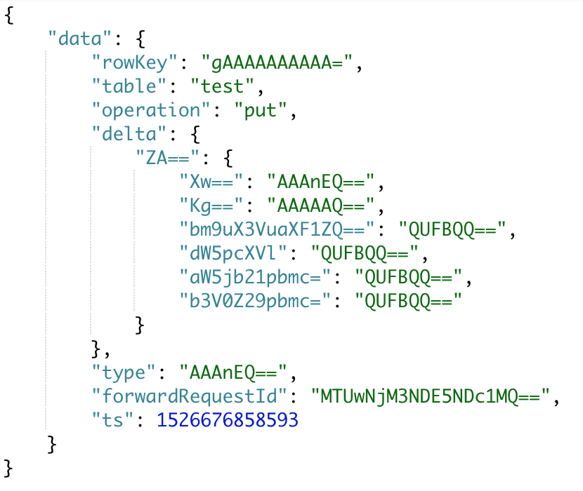
HBase Annotations
Part of Mutate
Written in WAL log, but not Memstore
Notes:
We also changed the hbase protocol to support hbase annotations, which allow customized info in hbase mutate request. The annotation is part of mutate, it works as a map of byte arrays. Like mysql comment, it will only be written in wal log but not memstore. Here is one hbase Kafka event example. We can see that the rowkey ,table, operation, delta changes, timestamp. The fields in red circle is from annotations. Hbase replication proxy will convert annotations as part of the kafka event.

Slide 18
HBase
Cluster A
Asynchonous Index
Replication
HRP
Async index for Zen and ads system
Update Index
publish
Async Index
Consume
Kafka
Notes:
Another case supported by these systems is out Async index. Since hbase itself does not support transaction or secondary index, originally we have to insert the entity and index data separately and this kind of double write pattern with cause index inconsistencies if one of the write failed. So for we used the systems built in multicell to enable our async index for hbase. So Another kafka consumer callsed async index service will consume the kafka event and update index to the hbase cluster. The index data will be inserted later and there will be a small gap of inconsistencies but by this pattern we guaranteed eventual consistency and most of clients are OK with this small gap.

Slide 19
HBase Timestamp
HBase
Cluster
Data service
Response with TS
Compare TS and update
Avoid race condition
Cache
Notes:
Another thing we did specific for hbase is the timestamp. In Pinterest, the service backed by hbase usually have higher write rate and it is likely that we may have race condition happened when data service tried to update cache. We modified the hbase protocol to ask hbase to return the timestamp for mutate request so that we update cache based on the timestamp.

Slide 20
Replication Topology Issue
US-East
US-West
HBase
M_E
HBase
M_W
HBase
S_E
HBase
S_W
Notes:
The last issue we met in multicell environment is the replication topology. We sometimes need to do operation on one hbase cluster and doing global failover by routing the traffic in load balancer side is too expensive. So in each cell, we keep two hbase clusters. If we set 4 replication links like this,

Slide 21
Replication Topology Issue
US-East
US-West
HBase
M_E
HBase
M_W
HBase
S_E
HBase
S_W
Notes:
If one cluster is down, the replication will still work. But if each cell has one cluster in trouble, our replication queue will be blocked.

Slide 22
Replication Topology Issue
US-East
US-West
HBase
M_E
HBase
M_W
HBase
S_E
HBase
S_W
Notes:
So to make sure that the replication queue can survive two clusters in trouble, we have to set up 4 choose 2 which is 6 replication links. But this is pretty heavy since each request will be replicated to the same cluster at most 3 times and waste a lot of hardware resource and cross cell traffic.

Slide 23
Replication Topology Issue
US-East
US-West
Get remote master region server list
HBase
M_E
HBase
M_W
ZK
ZK
Update zk with master’s region server list
HBase
S_E
HBase
S_W
Notes:
To solve the issue, we setup up a zookeeper proxy in each cell. In each cell, the two clusters will register its region server set to zookeeper depends on which one is the master. As long as the we failed over, the zk proxy will be updated with new master’s server list. For inter–cell, the local master cluster will enable the replication peer to the remote zk proxy. We’re still testing this solution and may have more results in future.
Next, Lianghong will talk about how we improve our hbase back process in Pinterest.

Slide 24
Improving backup efficiency
01
HBase backup at Pinterest
02
Simplifying backup pipeline
03
Offline Deduplication
Notes:
Thanks CJ, multi-cell makes Pinterest infrastructure tolerate failures from an entire cell. In addition to that, at Pinterest we use backup to enhance the availability of our critical data. While backup is a common practice in industry, in this talk, I’ll present how our backup pipeline has evolved over the years and how we were able to dramatically improve the HBase backup efficiency.

Slide 25
HBase Backup at Pinterest
HBase serves highly critical data
Requires very high availability
10s of clusters with 10s of PB of data
All needs backup to S3
Daily backup to S3 for disaster recovery
Snapshot + WAL for point-in-time recovery
Maintain weekly/monthly backups according to retention policy
Also used for offline data analysis
Notes:
As CJ mentioned, HBase is used by both online and offline services and serves highly critical data. We have 10s of clusters containing 10s of petabytes of data. All of the data needs to be backed up to S3 on a daily basis.
We do a combination of full and incremental backups. Specifically, we backup daily snapshots as well as write-ahead-logs for point-in-time recovery. For write heavy clusters WAL size could be large, but in our case, majority of backup data is taken up by the full daily backups.
For garbage collection, we maintain weekly and monthly backups and discard old enough backups. These backups are important in that they not only provide a disaster recovery mechanism, but also allows offline jobs to analyze the HBase dumps.

Slide 26
Legacy Backup Problem
Hbase cluster
Hbase cluster
…
Hbase cluster
HBase 0.94 does not support S3 export
Snapshots
and WALs
Two-step backup pipeline
HBase -> HDFS backup cluster
HDFS -> S3
HDFS backup cluster
Problem with the HDFS backup cluster
AWS S3
Infra cost as data volume increases
Operational pain on failure
Notes:
Before we dive in, I want to note that for historical reasons, Pinterest used HBase version 0.94 until lately when we did an version upgrade. When we first built the backup pipeline, there were no existing tools to directly export HBase snapshots to S3. The only supported method was to export snapshots to a HDFS cluster.
As a result, our original backup pipeline consisted of two steps: Exporting HBase table snapshots and write ahead logs (WALs) to a dedicated backup HDFS cluster. Uploading data from the backup cluster to S3.
However, as the amount of data (on the order of PBs) grows over time, the storage cost on S3 and the backup cluster continues to increase. It also incurs high operational overhead for us, since when the HDFS cluster is in trouble, our backup pipeline would be broken.

Slide 27
Upgrade Backup Pipeline
Hbase cluster
Hbase cluster
…
Hbase cluster
Hbase cluster
Hbase cluster
…
Hbase cluster
Snapshots
and WALs
Snapshots
and WALs
HDFS backup cluster
PinDedup
AWS S3
AWS S3
Offline
deduplication
HBase 0.94
HBase 1.2
Notes:
Recently we completed a HBase upgrade from version 0.94 to 1.2. Along with numerous bug fixes and performance improvements, the new version of HBase comes with native support to directly export table snapshots to S3.
Taking this opportunity, we optimized our backup pipeline by removing the HDFS cluster from the backup path.
In addition, we created a tool called PinDedup which asynchronously deduplicates redundant snapshot files to reduce our S3 footprint. We will talk about it later.

Slide 28
Challenge and Approach
Directly export HBase backup to S3
Table export done using a variant of distcp
Use S3A client with the fast upload option
Direct S3 upload is very CPU intensive
Large HFiles broken down into smaller chunks
Each chunk needs to be hashed and signed before upload
Minimize impact on prod HBase clusters
Constrain max number of threads and Yarn contains per host
Max CPU Overhead during backup < 30%
Notes:
One major challenge we encountered in the migration was minimizing its impact on production HBase clusters since they serve online requests. Table export is done using a MapReduce job similar to distcp. To increase the upload throughput, we use the S3A client with the fast upload option.
During the experiments, we observed that direct S3 upload tends to be very CPU-intensive, especially for transferring large files such as HFiles. This happens when a large file is broken down into multiple chunks, each of which needs to be hashed and signed before being uploaded. If we use more threads than the number of cores on the machines, the regionserver performing the upload will be saturated and could crash.
To mitigate this problem, we constrain the maximum number of concurrent threads and Yarn containers per host, so that the maximum CPU overhead caused by backup is under 30 percent.

Slide 29
Offline HFile Deduplication
HBase backup contains many duplicates
Day1 backup
Day2 backup
Observation: large HFiles rarely change
Account for most storage usage
Only merged during major compaction
For read-heavy clusters, much redundancy
across backup cycles
10GB
rs1/F1
rs1/F1
10GB
500MB
rs1/F2
rs1/F4
400MB
30MB
rs1/F3
rs1/F5
80MB
PinDedup: offline S3 deduplication tool
Largest file usually
unchanged
Asynchronously checks for duplicate S3 files
Replace old files with references to new ones
Notes:
Next, I’ll talk about how we deduplicate the backup files on S3 to dramatically reduce the storage usage.
The idea of deduplicating HBase snapshots is inspired by the observation that large HFiles often remain unchanged across backup cycles. While incremental updates are merged with minor compactions, large HFiles that account for most storage usage are only merged during a major compaction. As a result, adjacent backup dates usually contain many duplicate large HFiles, especially for read-heavy HBase clusters. As you can see from the right graph, the largest file F1 remains the same in the backup of day1 and day2, although the smaller files may be changed due to minor compactions.
Based on this observation, we designed and implemented a simple file-level deduplication tool called PinDedup. It asynchronously checks for duplicate S3 files across adjacent backup cycles and replaces older files with references.

Slide 30
PinDedup Approach
Day1 backup
Day2 backup
Source: s3://bucket/dir/dt=dt1
Target: s3://bucket/dir/dt=dt2
10GB
rs1/F1
Same file name and checksum
rs1/F1
10GB
Dedup candidates
rs1/F2
rs1/F4
400MB
500MB
30MB
rs1/F3
rs1/F5
80MB
Only checks HFiles in the same regions in adjacent dates
Declare duplicates when both filename and md5sum match
No need for large on-disk dedup index, very fast lookup
Notes:
Let me briefly explain how pindedup works. It’s simple yet very effective in removing duplicate backup files. It takes two inputs, which are the S3 locations of backup data in two adjacent dates. It traverses the directory hierarchy and determines for each region the set of HFiles. For each region, it compares the HFiles in both backup dates. In this example, let’s say region rs1 has 3 files F1, F2, and F3 when the first backup occurs. On the next day, F2 and F3 were changed probably due to minor compacitons, resulting two different files F4 and F5. However, if major compaction didn’t occur, the largest file F1 remained the same. After a result, simply by identifying the largest duplicate file, we were able to reclaim a lot of space.
Pindedup claims two files to be identical on when their names and hashs match. It is very simple since the comparison is done on a per-region basis. There is no need for on-disk dedup index and the duplicate detection is very fast.

Slide 31
Design Choices
File- vs. chunk-level deduplication
Online vs. offline deduplication
File encoding
Notes:
Despite the simplicity of PinDedup, there were several key design choices we had to make. We will mainly talk about three, namely File- vs. chunk-level deduplication, Online vs. offline deduplication, and how we encode deduplicated files.

Slide 32
File- vs. Chunk-level Dedup
More fine-grained duplication detection? -> Chunk-level dedup
Only marginal benefits
Rabin fingerprint chunking, 4K average chunk size
Increased complexity for implementation
During compaction, merged changes are spread across entire file
Large HFile
Small HFile
Before compaction
After compaction
Lessons
File-level dedup is good enough
Less aggressive major compaction to keep the largest files unchanged
Notes:
While-file deduplication has provided us good compression ratio. We were trying to take a step further to see how much more compression we could get. The hypothesis is that, if we use a more fine-grained dedup technique, such as variable-size chunk-level dedup, we should be able to save more space.
We actually implemented chunk-level dedup in pindedup. It computes rabin fingerpints with 4K average chunk size and indexes chunk hashes. The result turned out to be a bit surprising though, chunk-level dedup only brought marginal benefits, and we ended up not using it in production. We looked into this, and found the reason- during compaction, although the changes to be merged could be small, they spread all over the compacted file. This changed the content of most chunks, making chunk-level dedup not effective.
To conclude, we have learned two lessons in this process: first, file-level dedup is good enough for HBase backups. Second, we tune major compaction to be less aggressive and triggered only when necessary, so that the largest files are unmodified across backup cycles.

Slide 33
Online vs. Offline Dedup
HBase cluster
HBase cluster
PinDedup
File
checksums
Non-duplicate
files
All files
AWS S3
AWS S3
PinDedup
Online dedup:
reduces data transfer to S3
Offline dedup:
More control on when dedup occurs
Isolate backup and dedup failures
Notes:
Another design choice is online vs offline deduplication. The graph on the left shows the process of online dedup. Pindedup fetches file checksums from s3, does local comparison, and only transfer non-duplicate files to S3. This could potentially reduce the S3 transfer time. An alternative is offline dedup, shown on the right, where all backup files are first transferred to S3, and deduplication is done in an asynchronous manner.
While online dedup seems more effiicent, we eventually chose offline deduplication because it allows us to control when deduplication occurs. Since client teams often use the latest snapshots for offline analysis, we could delay the deduplication until the analysis jobs are finished. Doing so also separates the backup and dedup pipelines, so that dedup fail wouldn’t cause backup jobs to fail and itt’s easier for us to identify problems

Slide 34
File encoding
Dedup the old or new file?
Intuition: keep the old file, dedup the new one
Pros: one-step decoding
Cons: dangling file pointers when old files are deleted. E.g,
when F1 is garbage collected, F2’ and F3’ become unaccessible.
Design choice: keep the new file, dedup the old one
No overhead accessing the latest copy (most use cases)
Avoids the dangling pointer problem
Notes:
When identifying two duplicate files, one important question is whether to replace the older or newer file with a reference. We chose the former, because the latest files are much more likely to be accessed. Below I’ll try to argue why we made this choice. Suppose we replace the newer files with references, which we call “backward dedup chain”. This is actually a more intuitive way to encode files since you don’t rewrite old data. It also has the nice property that when accessing an deduplicated file, you only need one decoding step to recover the file. However, it causes a dangling problem when old files are deleted. E.g., when F1 is deleted due to retention policy, both F2 and F3 became un-recoverable.
In comparison, we chose the other approach. The key idea is to keep the latest file unchanged, since it’s most likely to be accessed. There is no decoding overhead to read the latest copy, and it avoids the dangling pointer problem. The tradeoff we have to make here is that recovering an older file may require multiple decoding steps.

Slide 35
Results
Reduced backup end-to-end time by 50%
3-137X compression on S3 storage usage
Significantly reduced infra cost
Lower operational overhead
Notes:
By upgrading the backup pipeline, we were able to reduce the e2e backup time by half. We obtained up to 2 orders of magnitude compression by use of deduplication. These two combined led to significantly reduced infra cost and lower operational overhead.

Slide 36
Thanks

